Slide 1
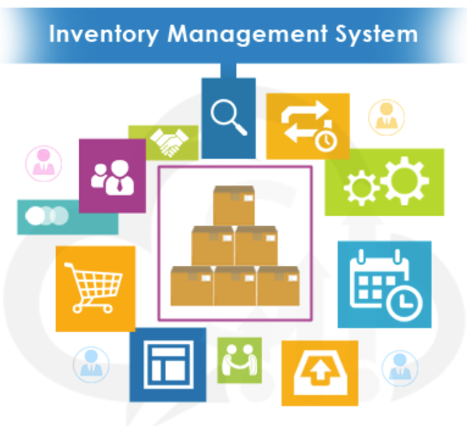
Apollo Hospital Inventory Management System
Presented by
Aishani Sood
Himani Chauhan
Neha Vipperla
Richa Sundrani
Steve Essi
Tasneem Boxwala
Seminar and Systems Development

Slide 2
Overview
Summary:
Name of Use Case | Hospital Inventory Management System
Challenge Statement | Apollo Hospitals is a multispecialty and widely spread medical care system. Hospital handles thousands of patients each day, experience emergency visits and it has become difficult for the management to track their inventory level resulting in over or under stocking. No mechanism to track orders that were shipped by vendors Manual tracking of product specification led to errors and omission No scientific method to distribute inventory orders leading to higher cost of procurement

Slide 3
SOP DEVELOPMENT
Roadmap
❶
❷
❸
❹
Planning Phase
Planning Phase
Planning Phase
Planning Phase
Project Vision
Architecture Vision
Use Cases
Retrospection
Requirements Gathering
WBS
Activity Diagrams
Peer Review
Stakeholder Management
Task Estimate
Test Cases
Interview Questions
Refinement of RTM
Risks

Slide 4
Proposed Solution
Solution to increase their accuracy of inventory management
Business Requirement
Analytical Model
Functional Requirements
Apollo Hospital Inventory Management System
Transition Requirement
Integration of various systems
Update of vendor data
Emergency Requirements
Optimal Distribution
Communication Requirement
Notification Management
Functional Requirements
RFID Tracking
Inventory Tracking
Functional Requirements
User Interface Requirement
Desktop / Mobile App
Stakeholder Requirement
Access to bypass automatic order process

Slide 5







Stakeholders
Hospital Administrator
Partner Hospitals
Vendors
Inventory Manager
Procurement Manager
Inventory Staff
Procurement Staff

Slide 6
Risks Identified
High
Low
Scope Creep
Incorrect time estimations
Lack of Domain Knowledge
Resistance to change

Slide 7
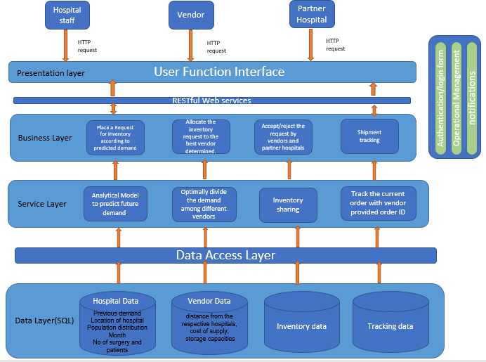
System
Architecture

Slide 8
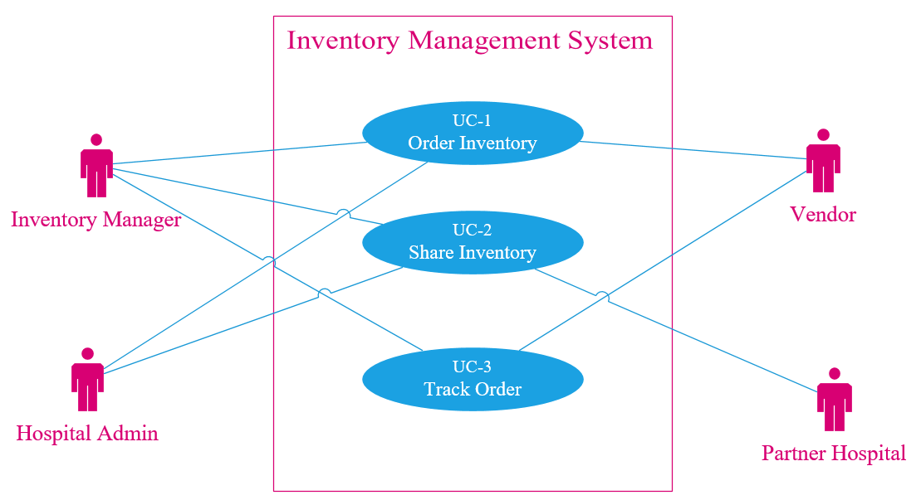
High level Use Case

Slide 9
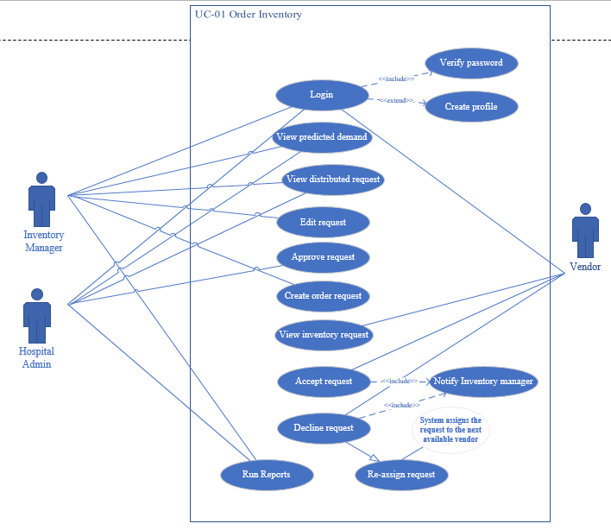
Order Inventory

Slide 10
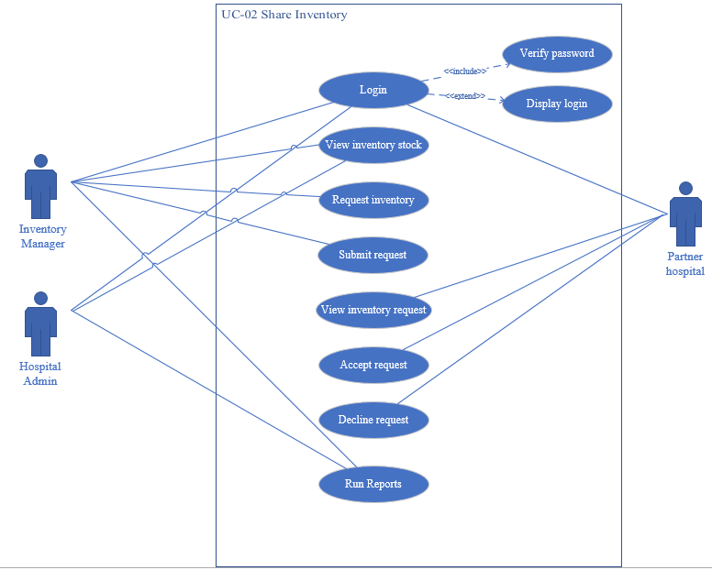
Share Inventory

Slide 11
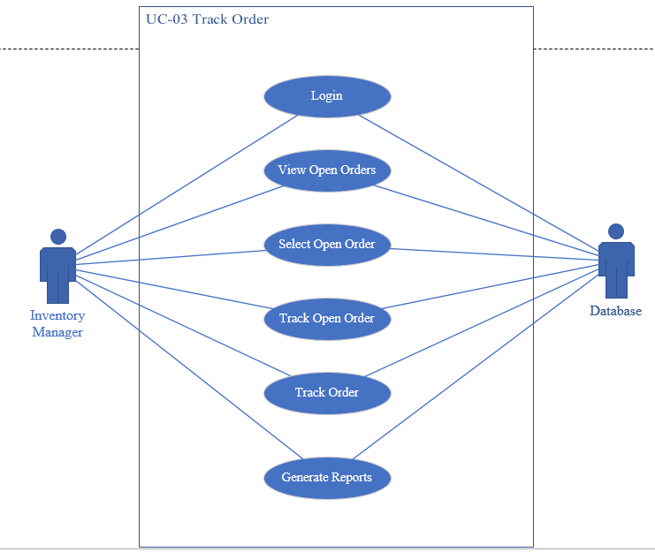
Track Order

Slide 12
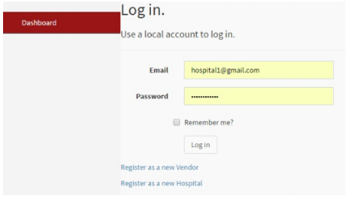
User Log In

Slide 13
Dashboard - Inventory Manager
Dashboard
Home>Dashboard
Oxygen Cylinders
14000 lts
Vendor A
Surgical supplies
5600 units
Vendor A
Insulin
8500 units
Vendor B

Slide 14
Dashboard - Vendor A
Dashboard
Home>Dashboard
Oxygen Cylinders
14000 lts
Accept Decline
Surgical supplies
5600 units
Accept Decline
Decline

Slide 15
THANK YOU

